Slide 1
A Low-Cost and Portable Electrocardiogram (ECG) Machine for Predicting Arrhythmia
Supervised by:
Ms.B.C.Kavitha
Assistant professor of ECE dept.
Presented by:(Batch18)
M DURGA PRADEEP (17121004)
K SASIDHAR (17121009)
CH ADITYA (17121005)

Slide 2
CONTENT
INTRODUCTION
OBJECTIVE
LITERATURE SURVEY
PROBLEM FORMULATION
COMPONENTS REQURIED
FEATURES OF GRAPH
ADVANTAGES
LITERATURE REVIEW
BLOCK DIAGRAM
INTERFACING ECG SENSOR WITH NODEMCU
RESULT AND DISCUSSION
CONCLUSION
REFERENCES
PUBLICATIONS

Slide 3
INTRODUCTION
Efficient health monitoring systems are in existence which can monitor the health parameters of patients in hospitals and also to moniter elderly persons at home.
An arrhythmia is a problem with the rate or rhythm of our heartbeat. It means that our heart beats too quickly, too slowly, or with an irregular pattern
ECG is a common technique to find abnormalities of heart there by the doctor can prescribe the nature of treatment to be continued.

Slide 4
Electrocardiogram (ECG) has been the golden standard for the detection of cardiovascular disease for many years.
Any electrical impulse disruption that causes the heart to the contract may lead to arrhythmia.
Arrhythmia patients have no indications of having an arrhythmia, but a doctor may recognize arrhythmias in a ECG test.

Slide 5
OBJECTIVE
An Iot based ECG monitoring system using Sensor AD8232 and NodeMcu is proposed.
Our project mainly focuses on designing and developing a method for predicting Arrhythmia(atrial fibrillation) along with monitoring the ECG signals.

Slide 6
LITERATURE SURVEY -1
1. P. Singh and A. Jasuja, “IoT based low -cost distant patient ECG monitoring system,” in Proceeding - IEEE International Conference on Computing, Communication and Automation, ICCCA 2017, 2017, vol. January, pp. 1330–1334.
ADVANTAGES
DRAW BACKS

Slide 7
LITERATURE SURVEY -2
M. Heron, “National Vital Statistics Reports Deaths: leading causes for 2013.,” Natl. vital Stat. reports from Centers Dis. Control Prev. Natl. Cent. Heal. Stat. Natl. Vital Stat. Syst., vol. 65, no. 2, pp. 1 –95,2016.
ADVANTAGES
DRAW BACKS

Slide 8
LITERATURE SURVEY -3
S. Saadatnejad, M. Oveisi, and M. Hashemi, “LSTM-Based ECG Classification for Continuous Monitoring on Personal Wearable Devices,” IEEE J. Biomed. Heal. Informatics, pp. 1–1, 2019.
ADVANTAGES
DRAW BACKS

Slide 9
LITERATURE SURVEY -4
R. H. Rakin, A. Siam, M. R. Hossain, and H. U. Zaman, “A low-cost and portable electrocardiogram (ECG) machine for preventing diagnosis,” in 1st International Conference on Robotics, Electrical and Signal Processing Techniques, ICREST 2019, 2019, pp. 48–53.
ADVANTAGES
DRAW BACKS

Slide 10
LITERATURE SURVEY -5
Afseen Naaz & Mrs Shikha Singh. (2015). QRS complex detection and ST segmentation of ECG signal using wavelet transform. International Journal of Research in Advent Technology, 3(6), 45-50.
ADVANTAGES
DRAW BACKS

Slide 11
PROBLEM FORMULATION

Slide 12
COMPONENTS REQUIRED:
S NO | Components Name | Description | Quantity
1 | NodeMCU | ESP8266-12E Board | 1
2 | ECG Sensor | AD8232 ECG Sensor Kit | 1
3 | Data Cable | 5V Micro USB Data Cable | 1
4 | USB Adapter | 5V Volt USB Adapter | 1
5 | Breadboard |  | 1

Slide 13
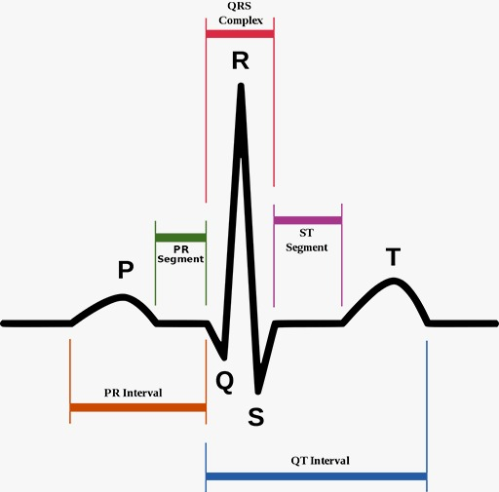
Features of ECG GRAPH Figure-1: shows the PQRST wave form.

Slide 14
ADVANTAGES OF THE PROJECT
Low cost ECG Monitoring system using ECG Sensor8232 and NodeMCU.
Predicting the chances of Arrhythmia with accurate results,will be beneficial for patients who are prown to Health issues and Elderly Bed ridden people.
Continuous wearable personal monitoring system plays a big role in arrhythmia detection.
ECG waveform can be monitered and analysed using IOT Platform called Ubidots.
ECG waveform can be used to detect hte different types of Arrhythmia using Machine Learning.

Slide 15
Literature review
S M Ahsanuzzaman & Toufik Ahmed,“Low Cost, Portable ECG Monitoring and Alarming System Based on Deep Learning”, Conference: 2020 IEEE Region 10 Symposium (TENSYMP)At: Dhaka, Bangladesh
Bansal, M.; Gandhi, B. IoT big data in smart healthcare (ECG monitoring). In Proceedings of the International Conference on Machine Learning, Big Data, Cloud and Parallel Computing: Trends, Prespectives and Prospects, COMITCon, Faridabad, India, 14–16 February 2019.

Slide 16
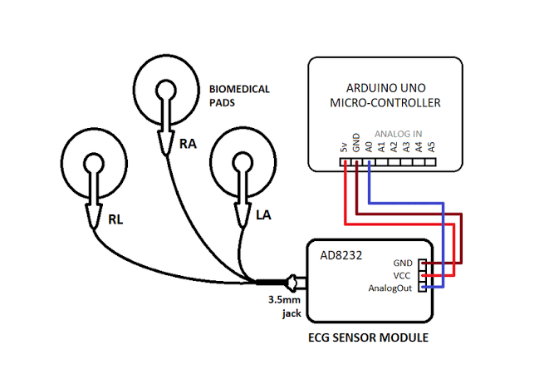
Block diagram of the proposed project Figure-2: shows the block diagram of the proposed project.

Slide 17
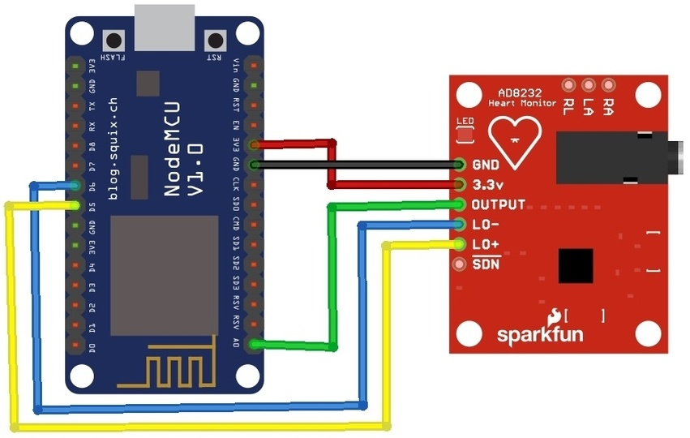
Interfacing AD8232 ECG Sensor with NodeMCU ESP8266 Figure-3: Represents the interfacing AD8232 ECG Sensor with NodeMCU ESP8266.

Slide 18
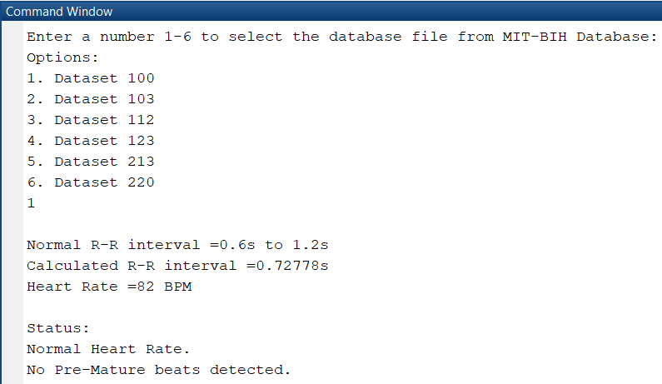
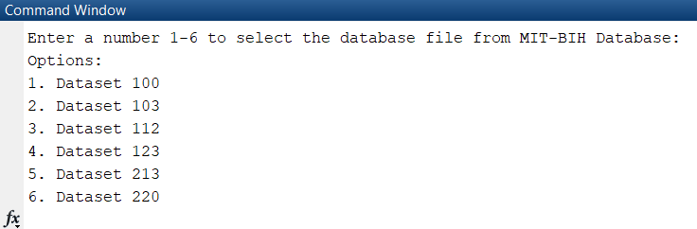
RESULT AND DISCUSSION 1) NORMAL HEART RATE
Fig -4: User selection of data record Fig-5: User selection of dataset 100 and Abnormalities display

Slide 19
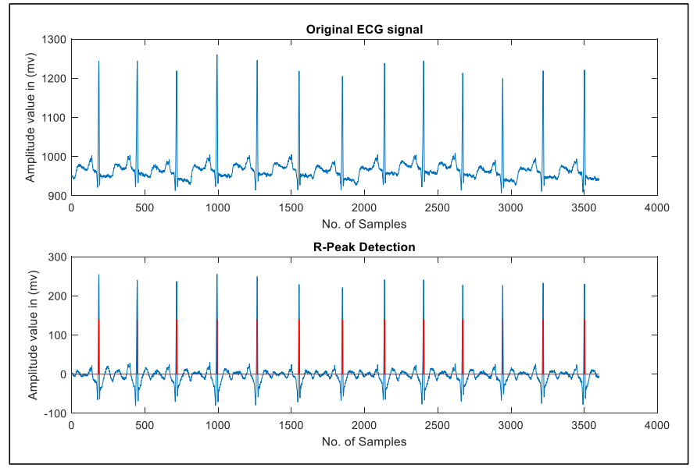
Figure-6 : Represent the dataset 100 ECG Waveform output and R-peaks waveform

Slide 20
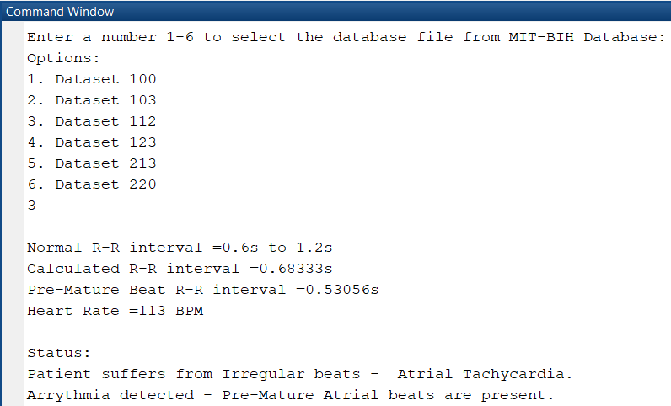
2) ATRIAL TACHYCHADIA Figure-7: User selection of dataset 112 and Abnormalities display.
The fig-7 represents the user selection of data set 112 and abnormalities display in command window. Atrial Tachycardia is a condition in which the heart rate is greater than 100 BPM.

Slide 21
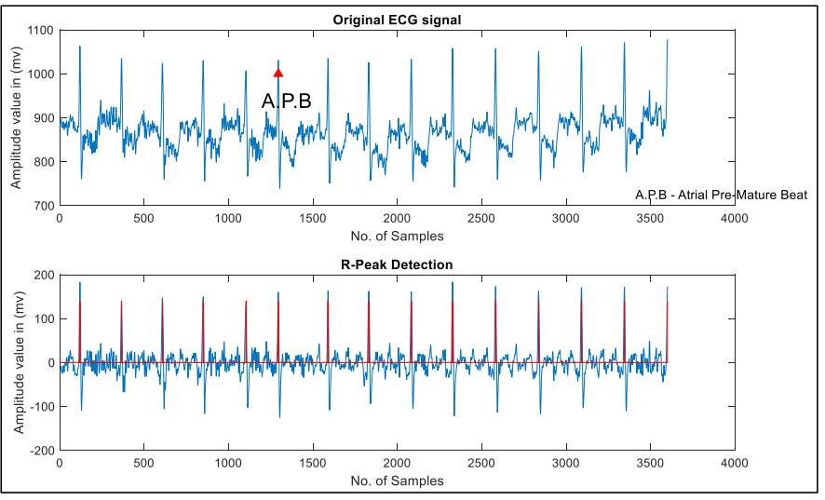
Fig 8: Dataset 112 ECG Waveform output
Fig 8 Represents the ECG waveform of dataset 112 and R-peak detected waveform. The output graph consists of original ECG waveform marked with the Atrial Pre-Mature Beat and R-peaks detected waveform.

Slide 22
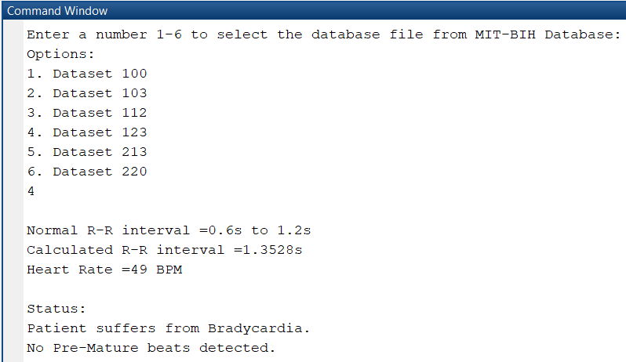
3) BRADYCARDIA Fig 9: User selection of dataset 123 and Abnormalities display
The above fig-9 shows Bradycardia has been detected. Bradycardia is a condition where the heart rate is lesser than 60 BPM.

Slide 23
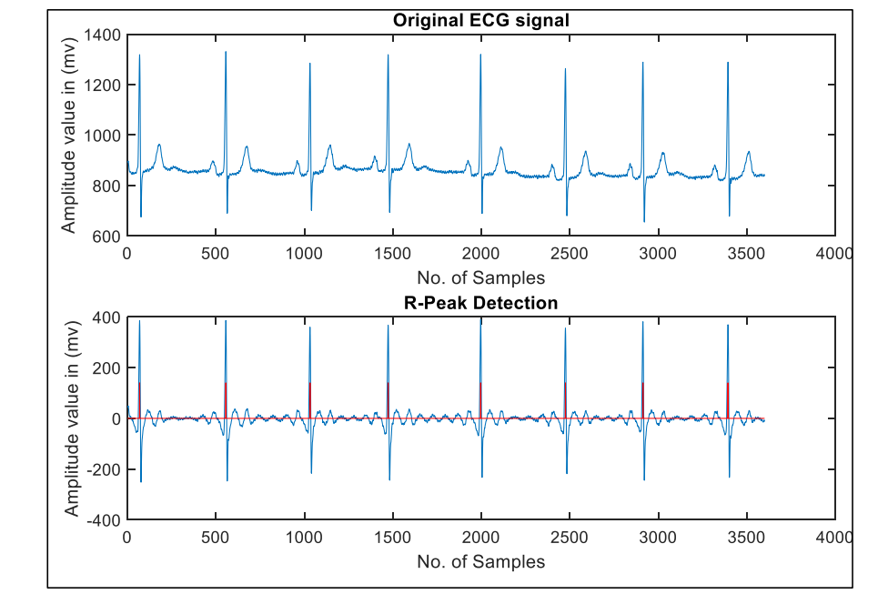
The above fig-10 represents the ECG waveform of the above dataset and R-peaks waveform. And slower heart rate is detected than normal heart rate and patient suffers from Bradycardia.
Fig 10: Dataset 123 ECG Waveform output

Slide 24
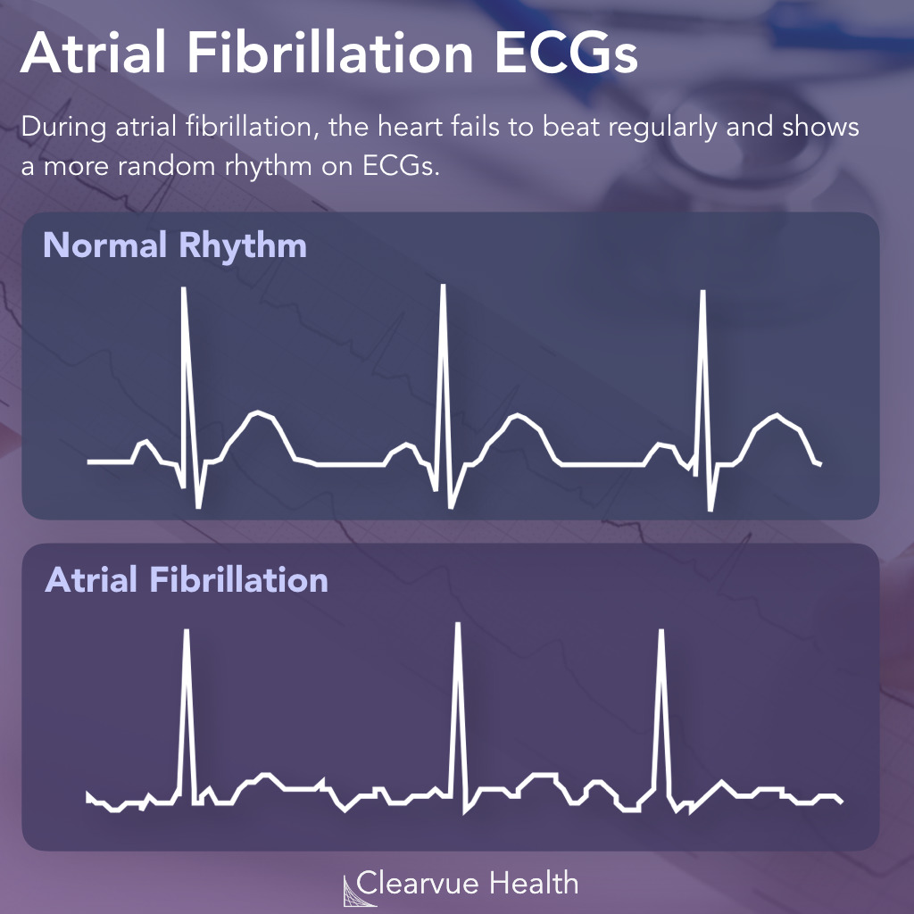
Comparison of ECG pattern obtained from ECG Sensor 8266 for Healthy person and Arrhythmia patient. Figure-11: Represents the difference in the heart rate of a normal person and Arrhythima person.

Slide 25
CONCLUSION

Slide 26
REFERENCES
P. Singh and A. Jasuja, “IoT based low -cost distant patient ECG monitoring system,” in Proceeding - IEEE International Conference on Computing, Communication and Automation, ICCCA 2017, 2017, vol. January, pp. 1330–1334.
M. Heron, “National Vital Statistics Reports Deaths: leading causes for 2013.,” Natl. vital Stat. reports from Centers Dis. Control Prev. Natl. Cent. Heal. Stat. Natl. Vital Stat. Syst., vol. 65, no. 2, pp. 1 –95,2016.
S. Saadatnejad, M. Oveisi, and M. Hashemi, “LSTM-Based ECG Classification for Continuous Monitoring on Personal Wearable Devices,” IEEE J. Biomed. Heal. Informatics, pp. 1–1, 2019.
R. H. Rakin, A. Siam, M. R. Hossain, and H. U. Zaman, “A low-cost and portable electrocardiogram (ECG) machine for preventing diagnosis,” in 1st International Conference on Robotics, Electrical and Signal Processing Techniques, ICREST 2019, 2019, pp. 48–53.

Slide 27
Afseen Naaz & MrsShikha Singh. (2015). QRS complex detection and ST segmentation of ECG signal using wavelet transform. International Journal of Research in Advent Technology, 3(6), 45-50.
Kritika Bawa & Pooja Sabherwal. (2014). R-peak detection by modified pan-tompkins algorithm. International Journal of Advancements in Research & Technology, 3(5), 30-33.
A.Muthuchudar & Lt. Dr. S.SantoshBaboo. (2013). A study of the processes involved in ECG signal analysis. International Journal of Scientific and Research Publications, 3(3). Available at: http://www.ijsrp.org/research-paper-0313/ijsrpp15114.pdf.
Yan Sun, KapLuk Chan, & Shankar Muthu Krishnan. (2005). Characteristic wave detection in ECG signal using morphological transform. BMC Cardiovascular Disorders. Available at: https://bmccardiovascdisord.biomedcentral.com/articles/10 .1186/1471-2261-5-28..

Slide 28
Contribution of individuals members
Aditya joshi (17121005) - Literature review,Prediction and and framing the Architecture.
K.Sasidhar (17121009) - Hardware assembly and Testing
M.DurgaPradeep (17121004) - Training and Testing using Machine learning Algorithms for Accurate prediction of different types of Arrhythmia.

Slide 29
PUBLICATIONS

Slide 30
THANK YOU

